Slide 1
Welcome to the MTLC
MATH 005 Spring 2015

Slide 2
Welcome to the MTLC
Instructors
Section 01: Pat Moore
Section 02: Pat Moore
Email your instructor at: ma005mtlc@as.ua.edu

Slide 3
Welcome to the MTLC
MA005 is a noncredit pass/fail course.
Its purpose is to ensure that you can pass MA100 Intermediate Algebra on your first try.
If you think you may not belong in this course, see me after class. There will be an opportunity tomorrow only to qualify for MA100 instead.

Slide 4
Textbook
Textbook – Beginning & Intermediate Algebra, 5th edition by Lial, Hornsby, McGinnis, published by Addison Wesley.
Textbook, lectures, assignments and tests are all on the web. Reach them through Blackboard Learn in your MyBama.
An access code is necessary to reach all course materials. You cannot begin to work until you have entered an access code into your account.
Notes:
4

Slide 5
Access Codes
Unless you are repeating this course from a previous semester which used the current edition of the textbook, you must have a new access code. Buy it with or without the paper textbook.
There is a 21-day grace period to work without purchasing an access code: select Temporary Access at the MyLabsPlus home page. NOTE: Once you use the temporary code you cannot put in your actual purchased code until the grace period ends; then you must enter it to continue any work.
You cannot work without a code, and MTLC does not want your work interrupted. See us right away if you anticipate any problems.

Slide 6
CALCULATOR
For tests, you will be allowed to use ONLY the CASIO FX-260-Student (available at University bookstores) or the calculator that is available on the computer.
Using another calculator is considered academic misconduct.
You must learn how to operate the calculator before testing. It’s a good plan to limit your calculator use at the start of the semester …

Slide 7
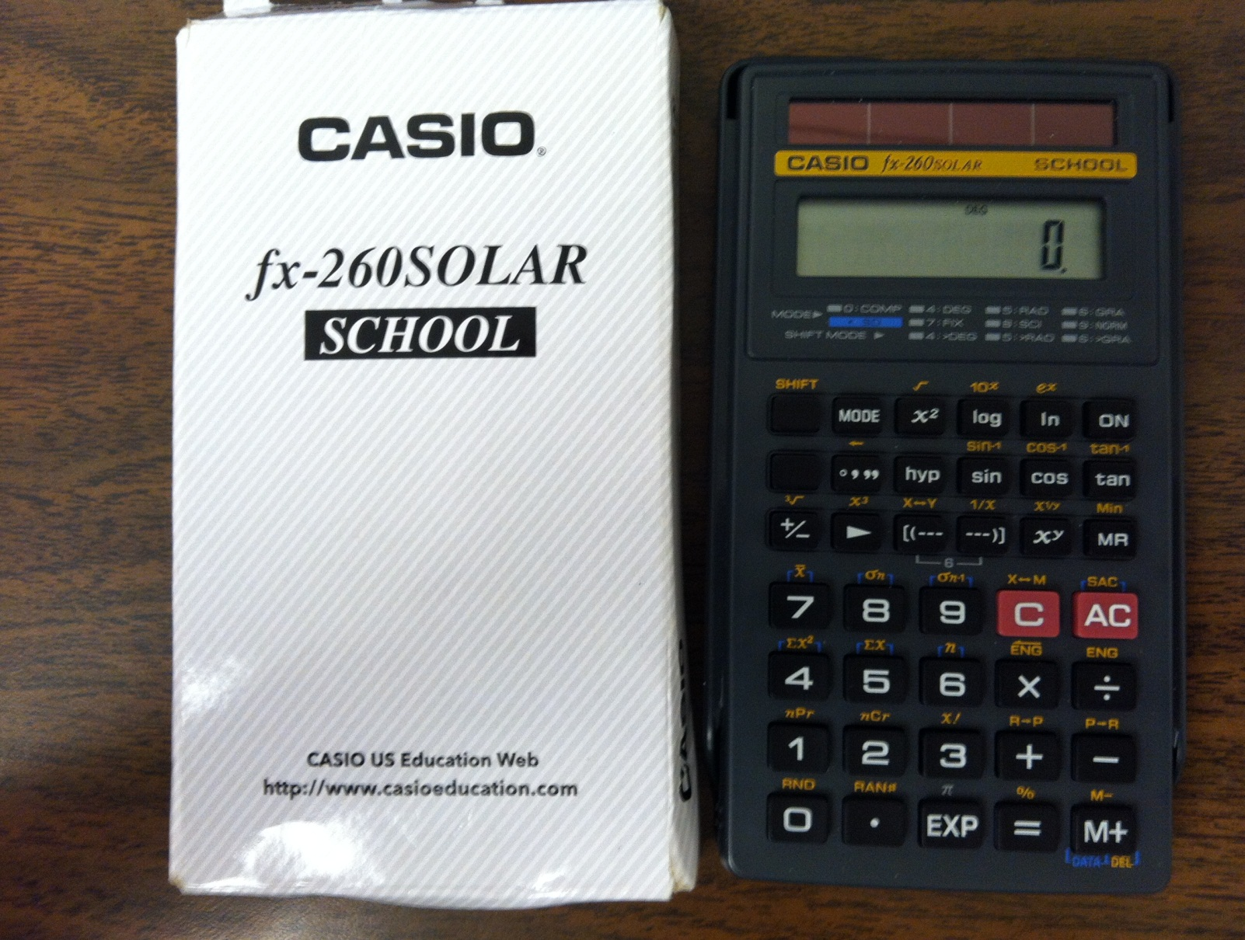
Look!

Slide 8
Course Grades
Your course grade will be P (pass) or F (fail); it will not affect your GPA and you will not earn credits toward graduation. Grade P will satisfy the prerequisite for MA100.
For the grade P, you must earn 70 % or better:
4 tests (100 points each) 40 %
Final Exam 30 %
Quizzes 9 %
Homework 9 %
Study Plan 3 %
Class Meetings 9 %
TOTAL 100 %

Slide 9
Class Attendance
Orientation will be Thursday, 1/7.
All students are required to come to the lab at their scheduled class times on Tuesdays and Thursdays for their weekly class meetings.
For full attendance credit for each class meeting, you must sign the class roll and you must stay for the full 75-minute scheduled time. Swipe your ACT card as you enter and as you leave the MTLC to record your time.
After you take your Final Exam and have passed MA005, you will be credited with attendance for all remaining class meetings.
Anyone caught swiping another student’s card will be charged with academic misconduct.

Slide 10
Lab Hours
There are no required lab hours in Math 005 other than your 2 regular class meetings per week.
You may go to the MTLC any time it is open for tutoring or assistance with your math work. We encourage this strongly.

Slide 11
MTLC Information—B1 Tutwiler
Hours of Operation
Monday – Thursday: 8:00am – 10:00pm
Friday: 8:00am – 4:45pm
Closings
MLK Holiday: Monday 1/19
Spring Break: Monday 3/16 - Friday 3/20
Last day for help in the MTLC will be Friday 4/24
Phone Number: (205) 348 – 2592
Website: www.mtlc.ua.edu
EMAIL: ma005mtlc@as.ua.edu
Please put your instructor’s name in the subject box for email.
Notes:
11

Slide 12
Common Rules for the Center
ABSOLUTELY NO FOOD, DRINKS, CELL PHONES, COMPANIONS, TOBACCO PRODUCTS,OR PROFANITY ARE ALLOWED.
NO EXCEPTIONS!!

Slide 13
Quizzes & Homework
MA005 has 25 graded homework assignments; most correspond to one section of the textbook. Multiple attempts are allowed on homework questions, and you can save your homework and return to it later.
Each homework has a corresponding quiz. Click on the “Submit” button when you are ready to score your quiz and save its score. If you need to leave then return to a quiz, just close your browser window without submitting. You have an unlimited number of attempts on quizzes. Your best score will be used when calculating your grade.
At the end of the semester you will be allowed to drop three homework grades and three quiz grades.
Notes:
13

Slide 14
Quizzes & Homework
Notes:
14

Slide 15
MML Study Plan
The MML Study Plan is worth 3% of your overall grade. In MA005, the Study Plan does not cover material from Test 1 and Test 2.
You can get access to the MML Study Plan by clicking on the “Study Plan” tab on the left side of the software.
The MML Study Plan will need to be completed by the end of final exam week.

Slide 16
Study Plan cont.
During the course of the semester your study plan will be updated after every quiz. When you miss a problem on a quiz, your study plan will show that you need to do extra work on that problem’s topic in order to improve in the course. So, please take every quiz seriously and do your very best!
Inside the study plan you will be able to work on the types of problems that you are having difficulty with. When you feel like you understand and have mastered one of these difficult areas you may take a short 4-problem quiz. If you are successful on the quiz, your study plan will then be updated showing this mastery.
The MML Study Plan will be individual and unique to just you!

Slide 17
Tests
There will be 4 tests and a comprehensive final given during the semester. All tests combined count for 70% of your grade.
Tests days are shown on the front page of your syllabus.
During test weeks, the MTLC will be available for study and working on assignments during normal hours on Monday and Friday, but only between 9-10 PM on Tuesday-Thursday. MA005 classes will NOT meet.
You will need to register for a test time for all Tests during test registration periods as noted on the front page of your syllabus. We will begin this process on Monday 1/19. Stay tuned for details.

Slide 18
Test Replacement Policy
Students will be allowed to replace the lowest regular test score with the score made on the final exam. However, scores penalized due to academic misconduct will not be replaced. Final Exams will still count the normal 30% as well. Notice this means HALF your course grade may be determined by testing in the last two weeks of the semester.

Slide 19
Working at Home
Homework and quizzes may be completed at home. However, if grades are not successfully sent from home for any reason, you will not be able to retry the work after the deadline has passed. Work ahead, or work at the MTLC.
The math software does not work well with SAFARI browser found on Apple products. Use Firefox as your browser and you should have success.
If you ever encounter “Time Out Errors” on your personal computers, try clearing recent history and deleting Cookies, or try a different browser. At the MTLC, try moving to a different computer.
Tests must be completed in the MTLC.

Slide 20
Problems or Questions
If you have ANY trouble with the software or with reaching your assignments, then you need to come by the MTLC during operating hours and let someone assist you.
In fact the answer to almost ALL questions or problems is “come to the lab and ask” … and better sooner than later.

Slide 21
Extra Help: CAS
Center for Academic Success (Osband Hall) has many resources at your disposal:
Free individual tutoring sessions are available in Osband Hall by appointment and on a walk-in basis.
Go to www.cas.ua.edu to see times for help sessions and test reviews or to schedule a tutoring appointment.
CAS now offers online tutoring sessions; check the web site. Also check for additional support material. Topics go way beyond math help!

Slide 22
Disability Accommodations
Office of Disability Services
348-4285
Bring paperwork from ODS to your instructor or directly to the MTLC.
Do this as soon as possible.
Must be done anew each semester.

Slide 23
Network Access Login
Your login for the MTLC computer network will be your MyBama login information.
If you do not know this information, please go to the OIT help desk located on the ground floor of Gordon Palmer Hall.

Slide 24
Course Software Access
Unless you added MA005 very recently, you are already registered in MyLabsPlus.
Log in to MyBama, go to Blackboard Learn, select your MA005 course, and click on the MyLabsPlus Bridge link. You should find yourself at the home page of the MA005 course. Click on Gradebook, then press on: eventually you’ll be asked to enter your purchased access code. Do it (once ONLY).

Slide 25
Backup Software Login
Note: If myBama is down, here’s another way:
Website: www.ua.mylabsplus.com
Username = crimson email prefix (ex: jksmith)
Password = CWID (ex: 12345678)

Slide 26
Final Thoughts
We are looking forward to your success in this course.
Work hard
Get help
Enjoy the semester!

